Slide 1
CERN: Wandering the Immeasurable
Belgin Seymenoglu
Twitter: @DrSmokyFurby
Mathstodon: @Smoky@mathstodon.xyz
Bluesky: @drsmokyfurby.bsky.social

Slide 2
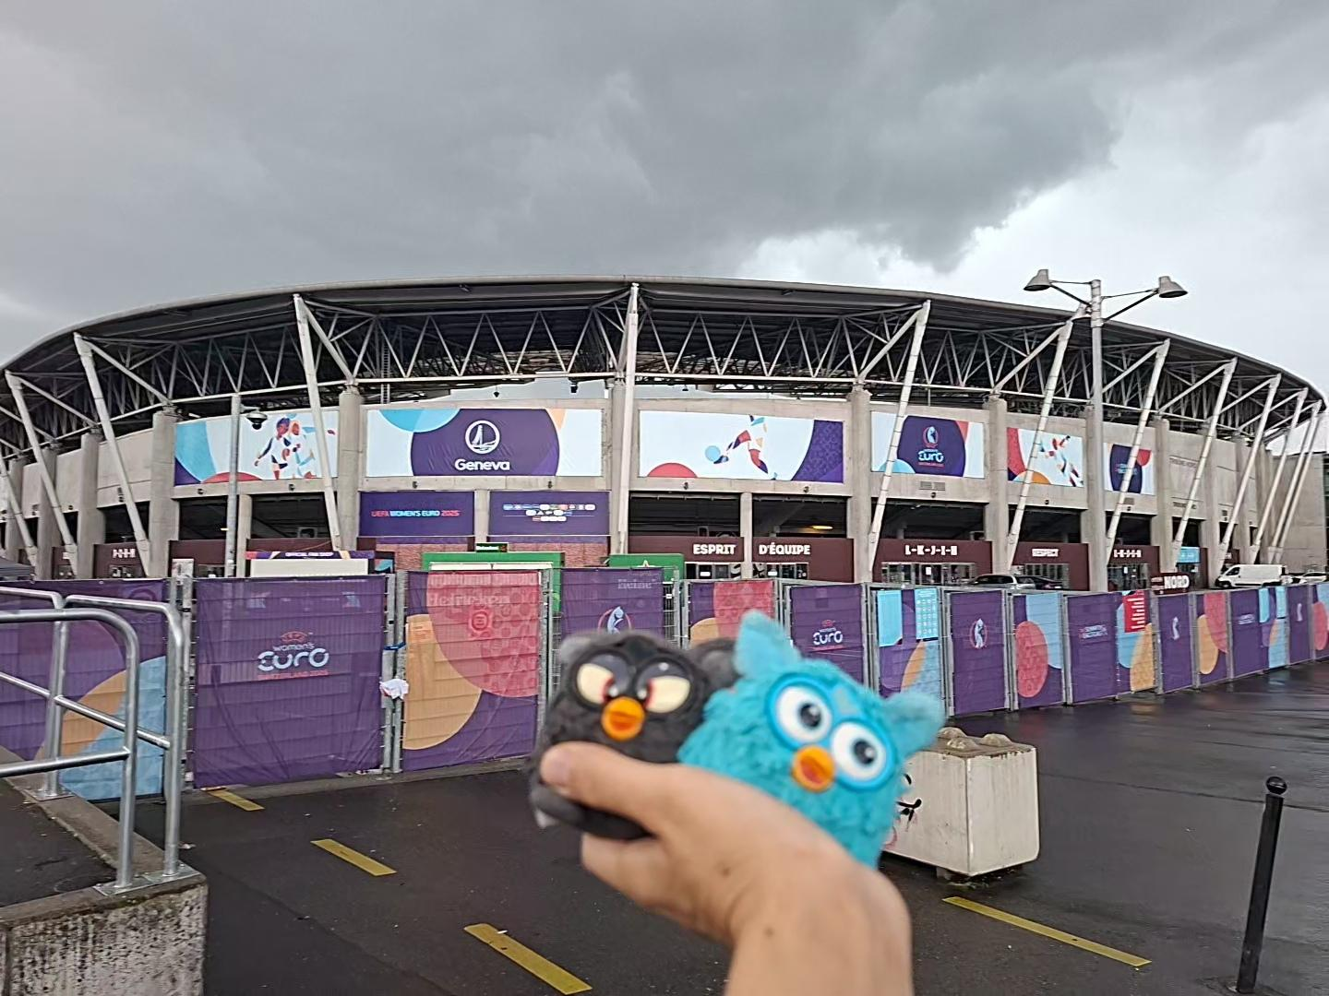
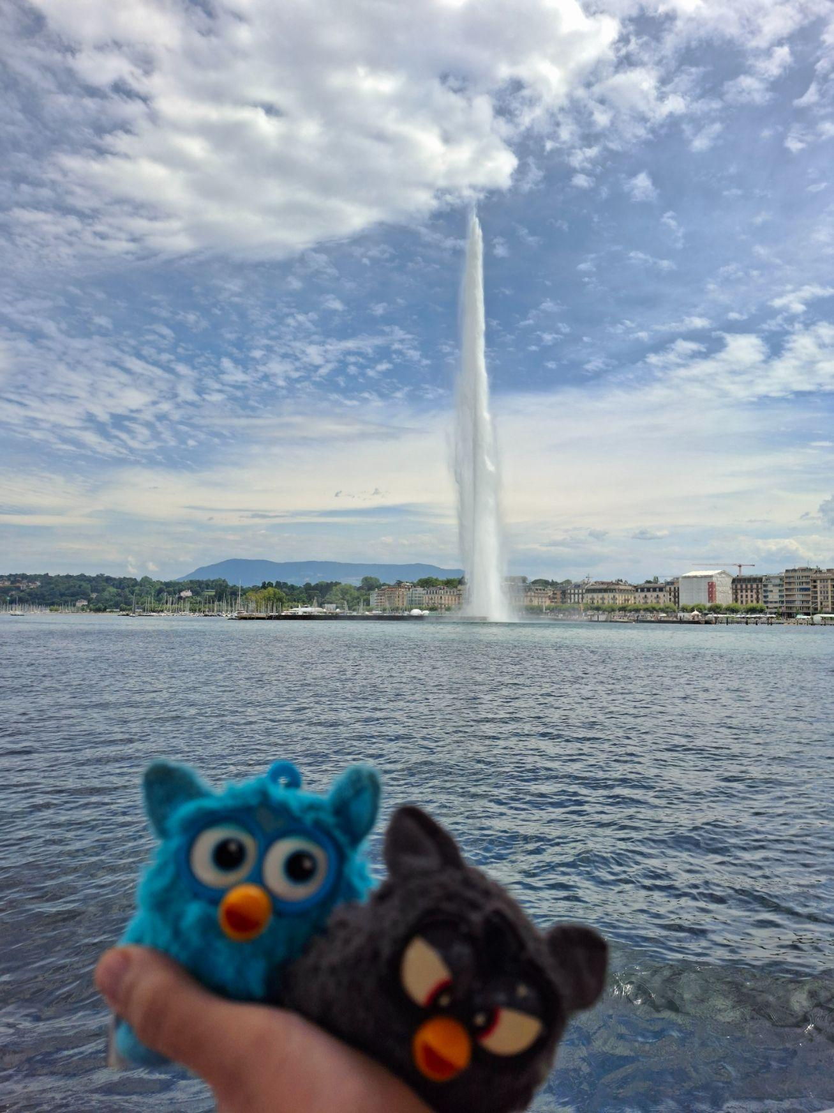
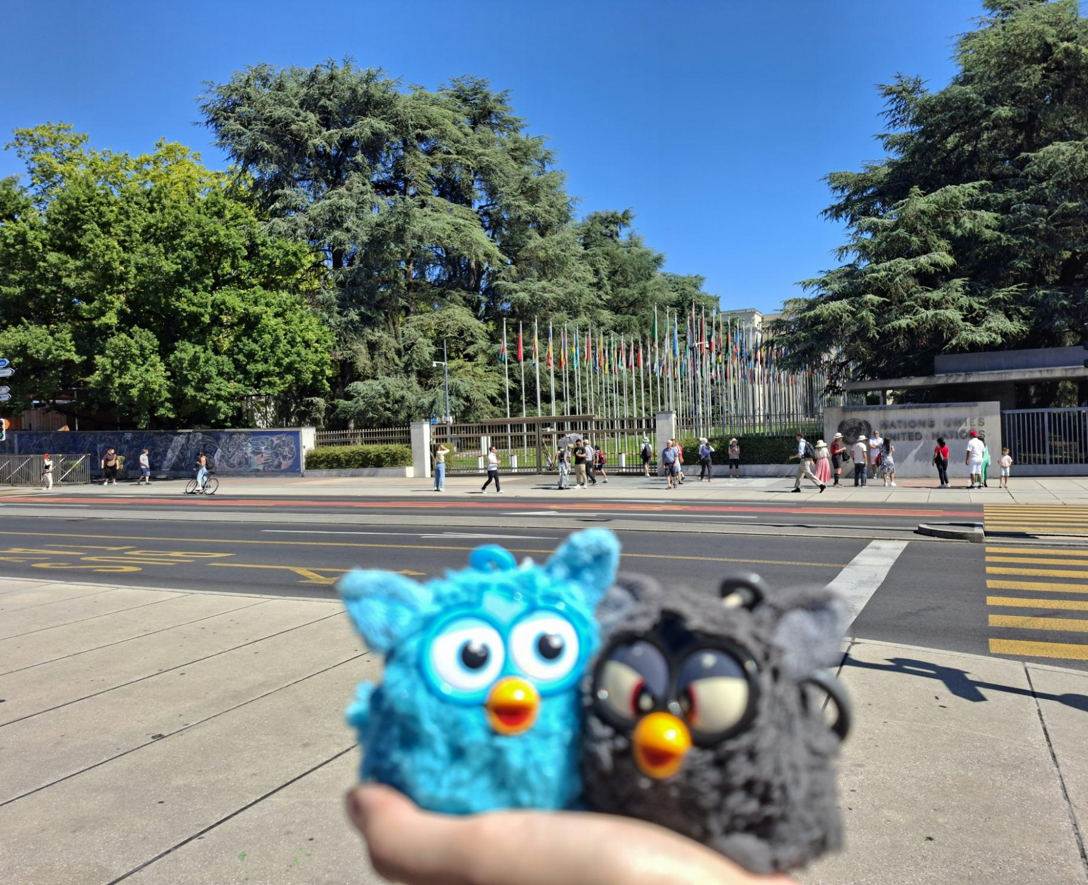
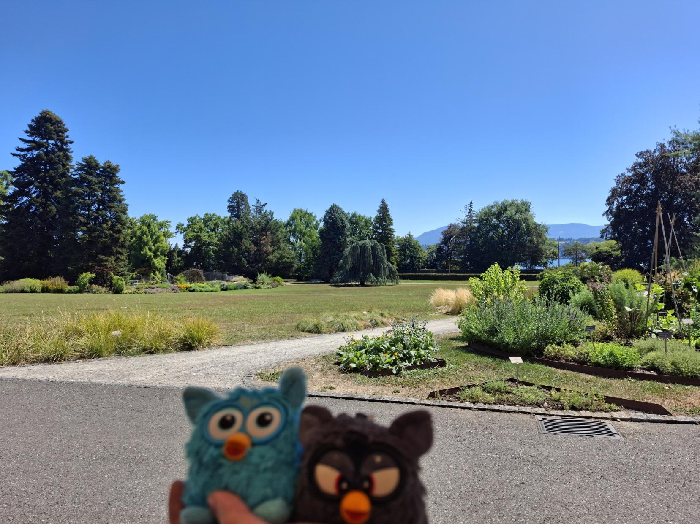
Geneva holiday: July 17-21st

Slide 3
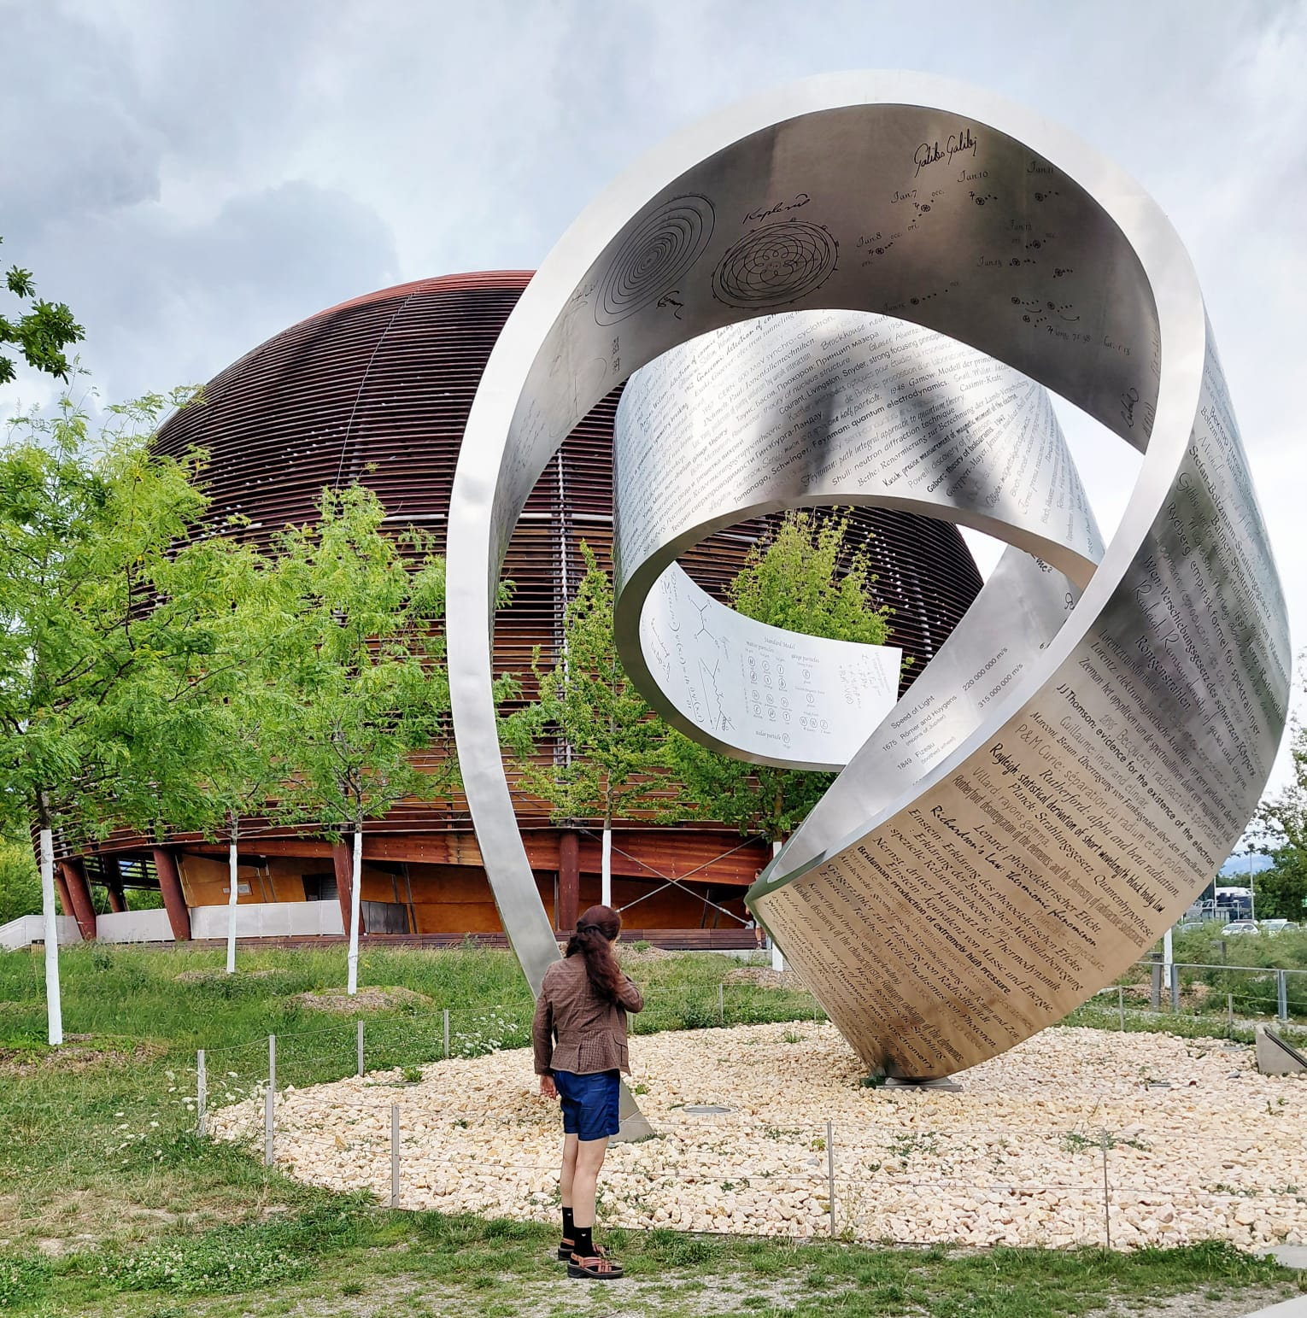
July 20th, CERN

Slide 4
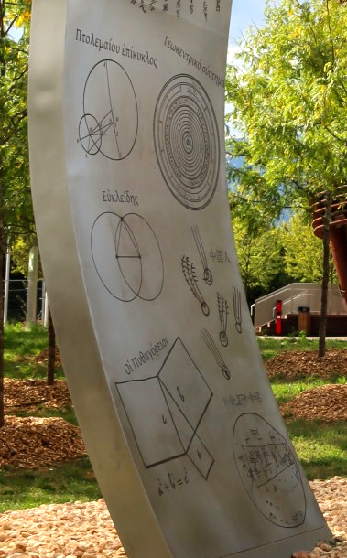
Wandering the Immeasurable: Math side
Ptolemaic epicycle
Geocentric system ❌
Euclid, geometric construction
Chinese records of comets
Pythagoras’
Theorem
Babylonian sky maps
Mike Peel (www.mikepeel.net), CC BY-SA 4.0

Slide 5
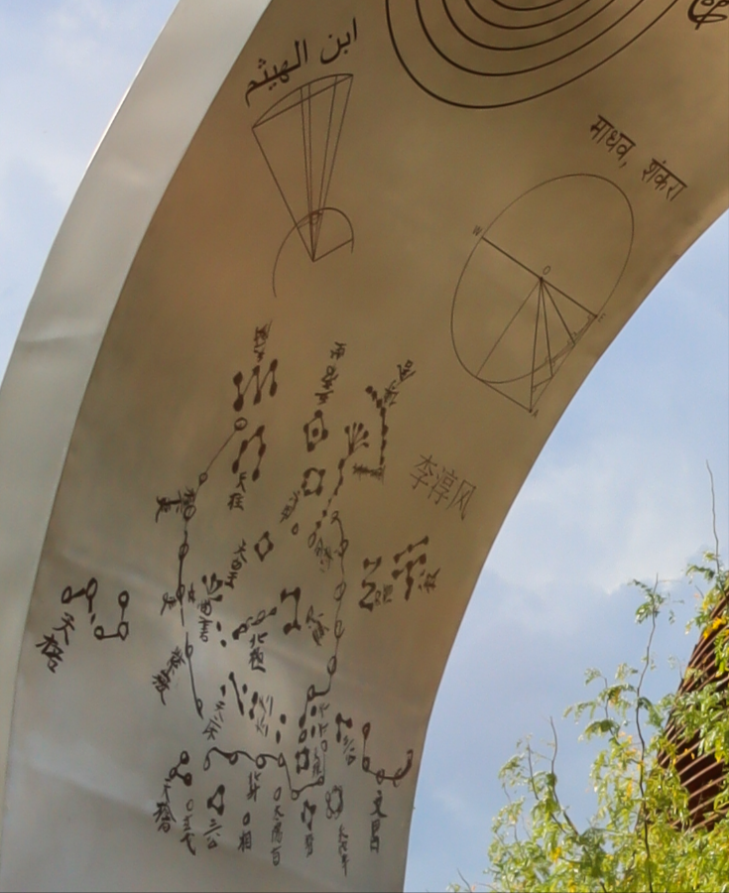
Wandering the Immeasurable: Math side
Circle theorems
Ibn al-Haytham, “the father of modern optics”
Dunhuang star chart
Mike Peel (www.mikepeel.net), CC BY-SA 4.0

Slide 6
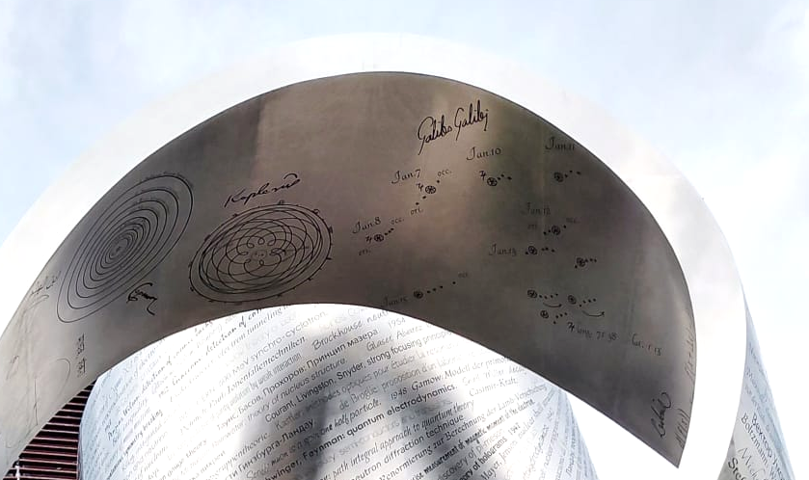
Wandering the Immeasurable: Math side
Galileo observing Jupiter’s moons
Kepler’s laws of planetary motion
Copernican heliocentrism

Slide 7
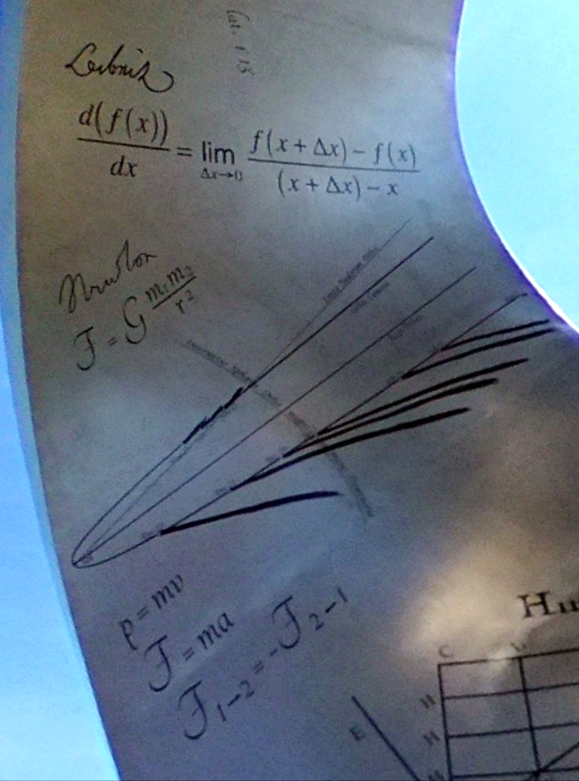
Wandering the Immeasurable: Math side
Leibniz & calculus
Newton’s Laws
Simon Waldherr

Slide 8
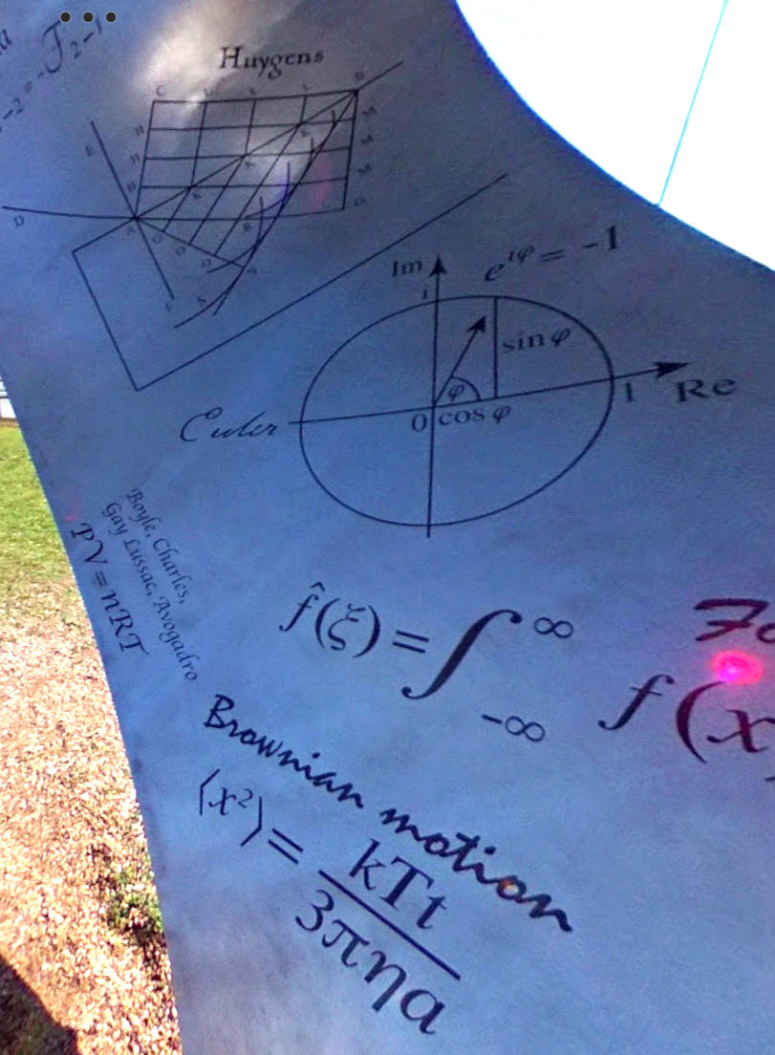
Wandering the Immeasurable: Math side
Huygens’s construction of refraction
Euler’s formula, complex numbers
Ideal gas equation
Mean squared displacement, Brownian motion
Simon Waldherr

Slide 9
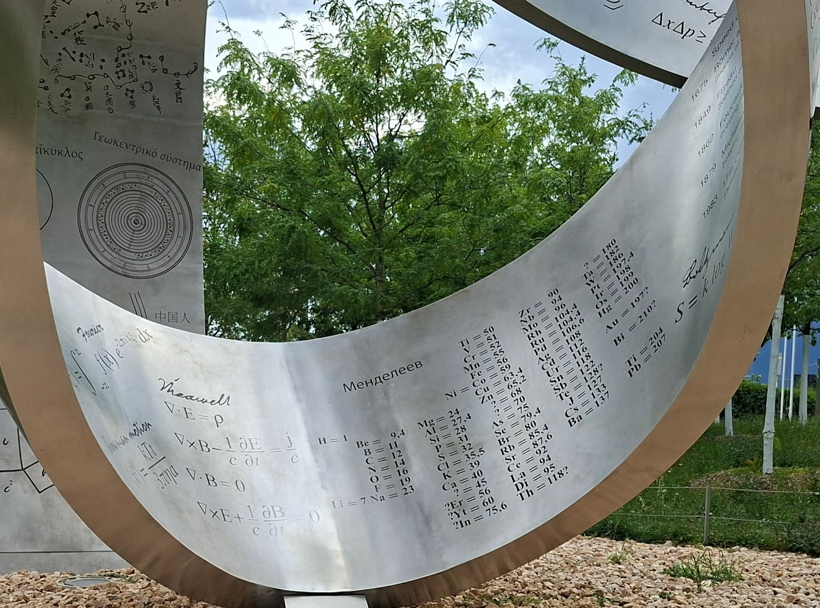
Wandering the Immeasurable: Math side
Fourier transform
Maxwell’s equations
Mendeleev, periodic table

Slide 10
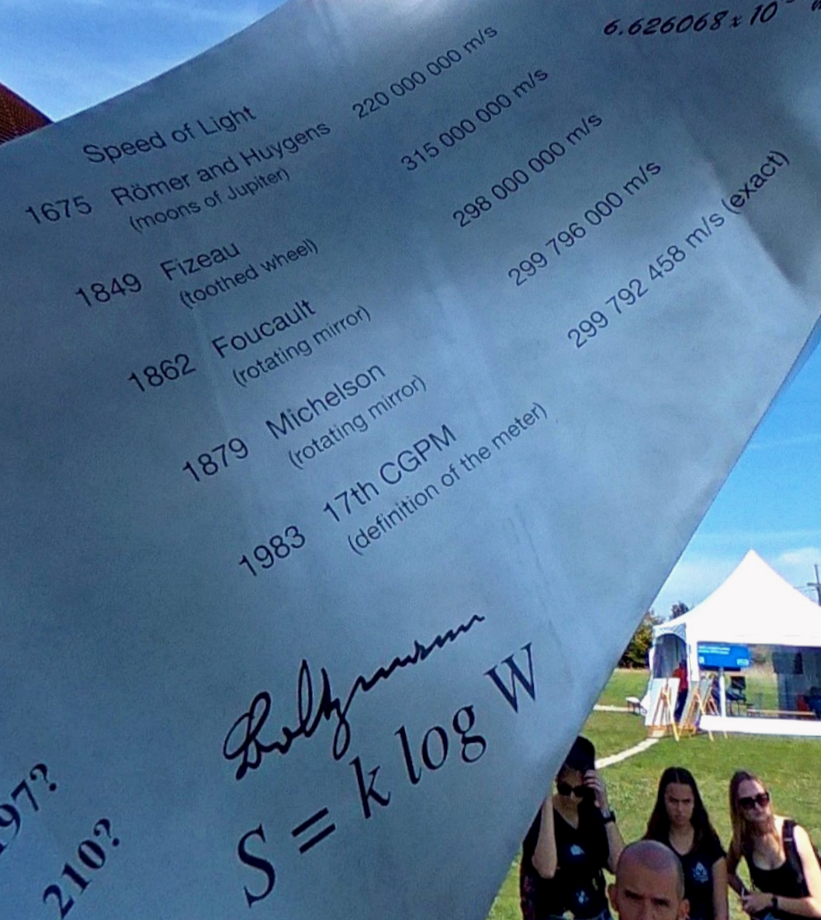
Wandering the Immeasurable: Math side
Speed of light estimates
Boltzmann's entropy formula
Simon Waldherr

Slide 11
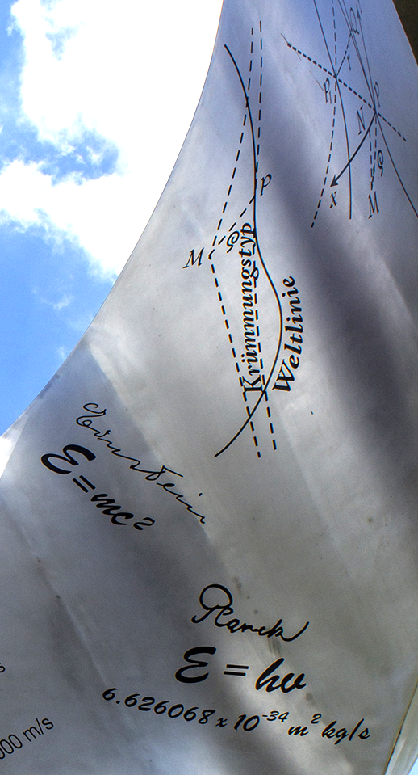
Wandering the Immeasurable: Math side
World lines in spacetime
E = mc²!
Planck-Einstein relation
Cchimko, CC BY-SA 4.0

Slide 12
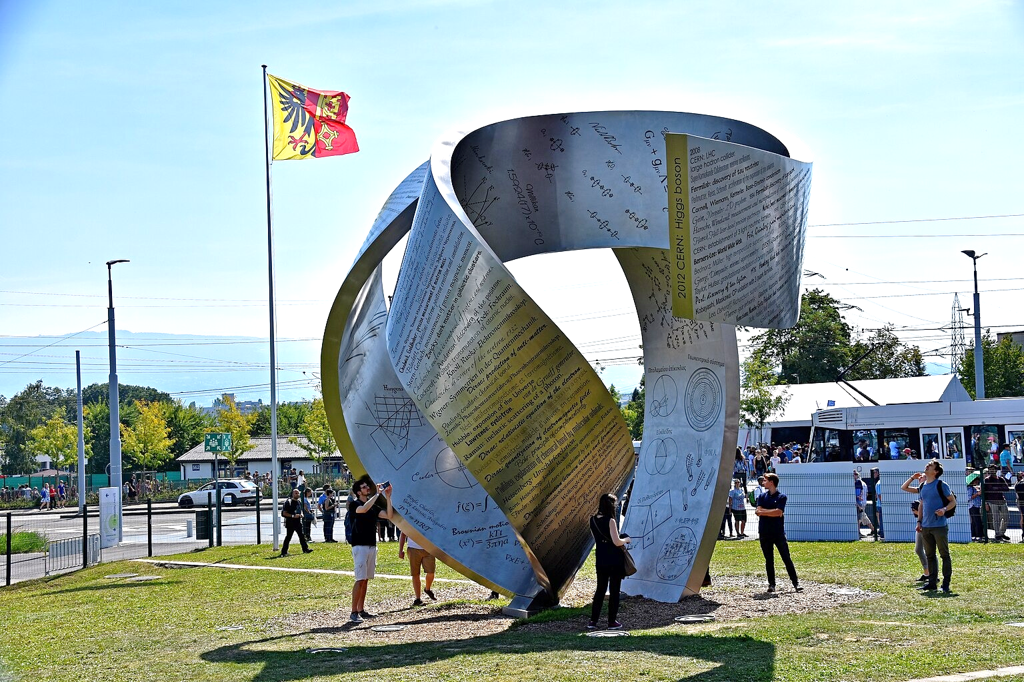
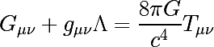
Wandering the Immeasurable: Math side
Milikan estimated the charge of a proton
Niels Bohr,
Molecular configurations
Einstein field equations
Minkowski, special relativity
Cchimko, CC BY-SA 4.0

Slide 13
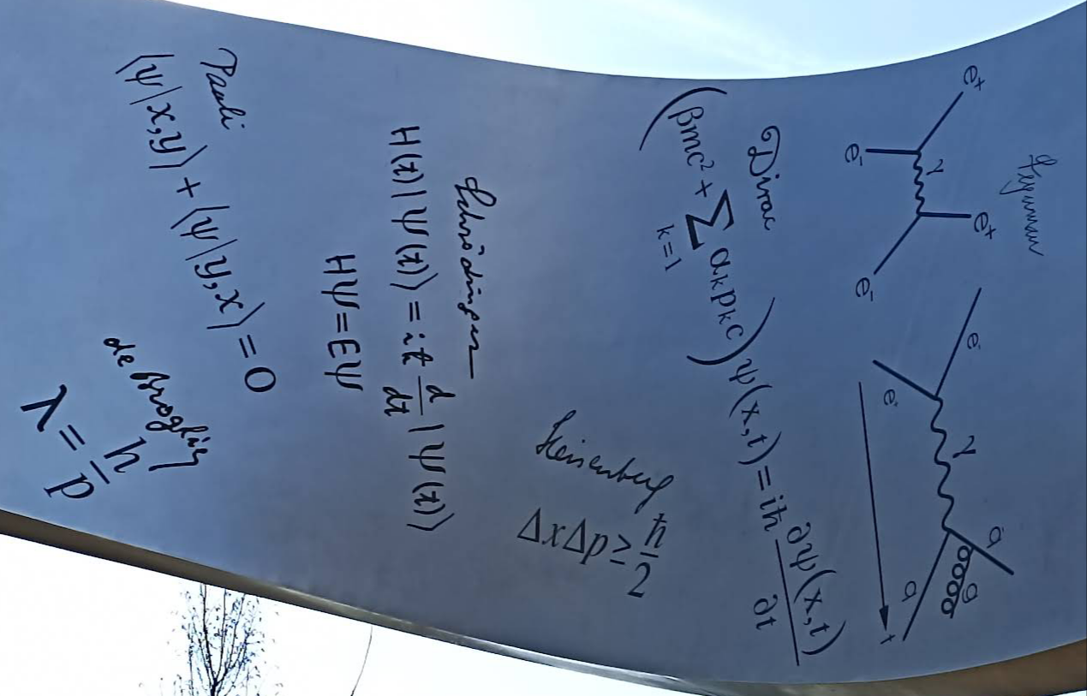
Wandering the Immeasurable: Math side
Dirac equation
Pauli exchange principle
Schrodinger’s equation
Feynman diagrams
De Broglie, wave-particle duality
Heisenberg, Uncertainty Principle
Rafael Leite Patrao

Slide 14
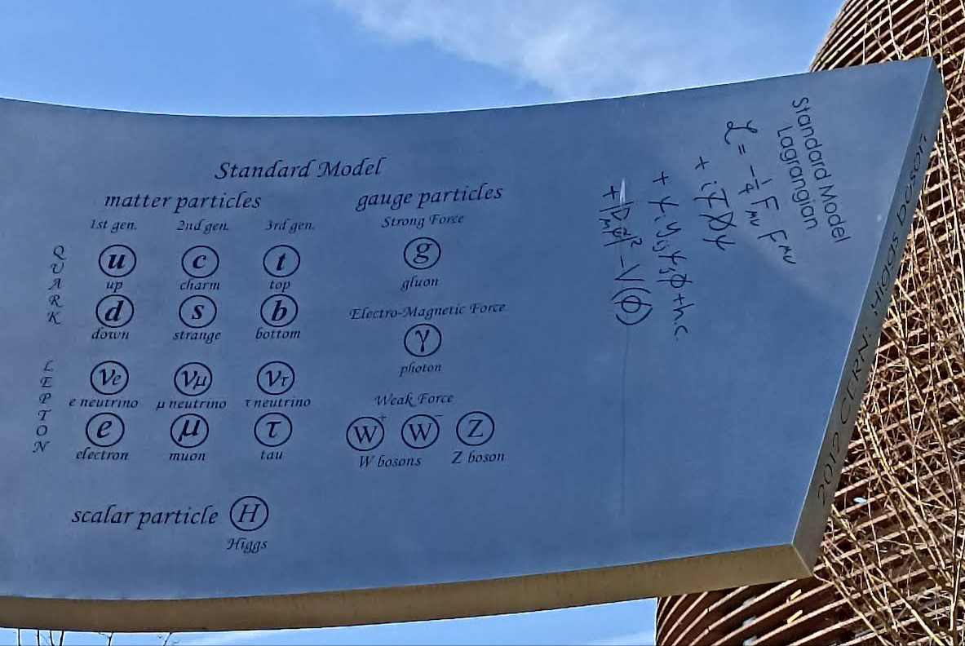
Wandering the Immeasurable: Math side
Rafael Leite Patrao

Slide 15
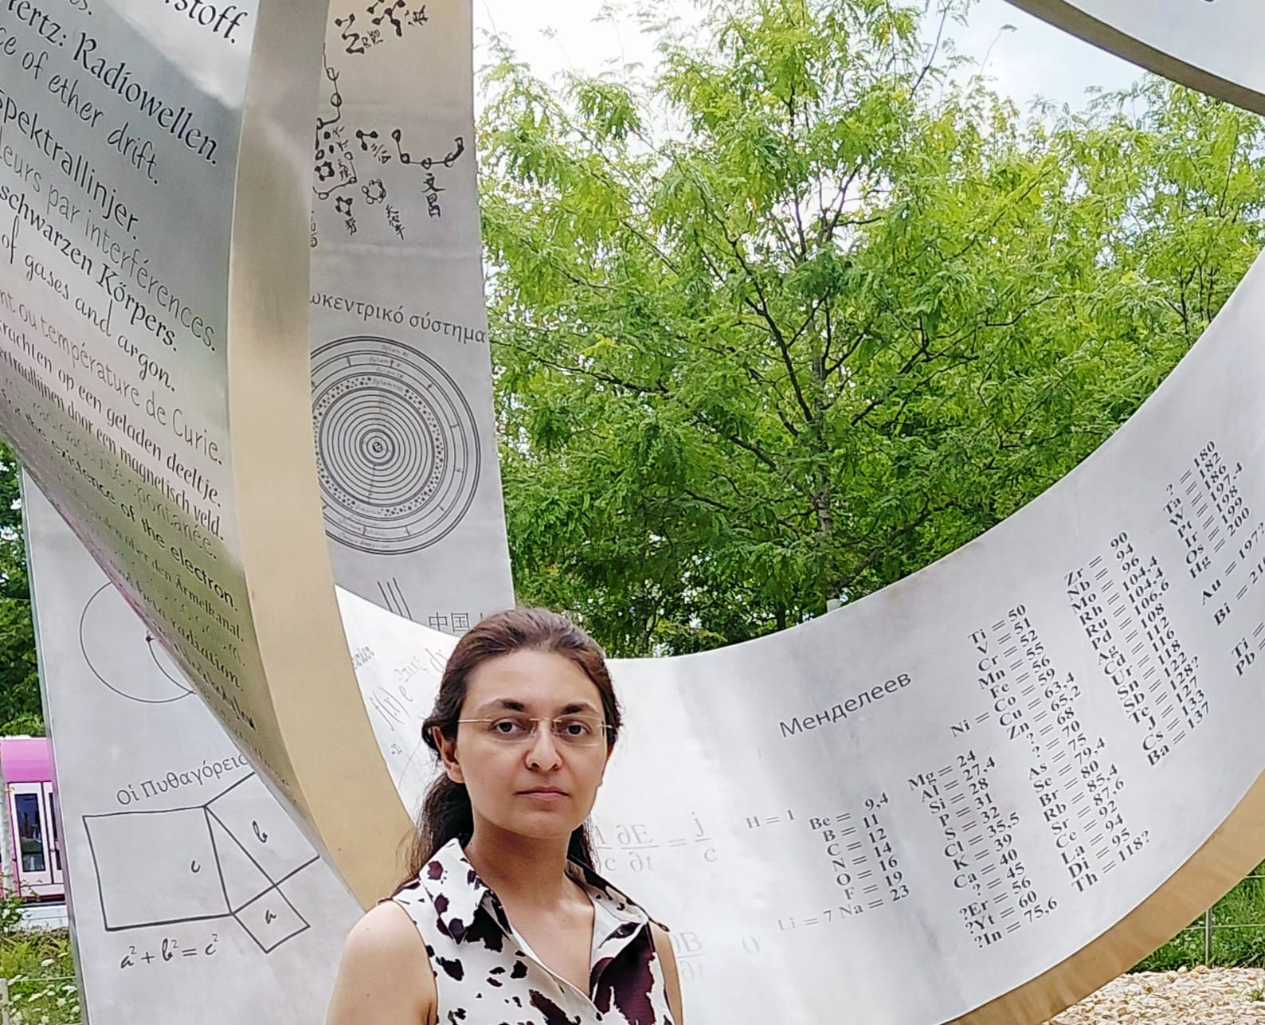
Thanks for listening!

